Slide 1
Role Marketing in
Business Success
Dr. Maung Maung Zaw
09-260609011
mmzawmyan@gmail.com
17 December 2017

Slide 2
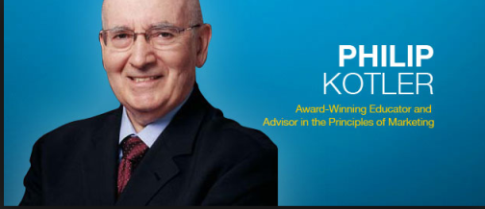
Mission of marketing?
To sell any and all of the company’s products
To anyone and everyone.
Create products that satisfy the unmet needs of target markets.
To raise the standard of living and the quality of life.
Create new and attractive solutions.

Slide 3

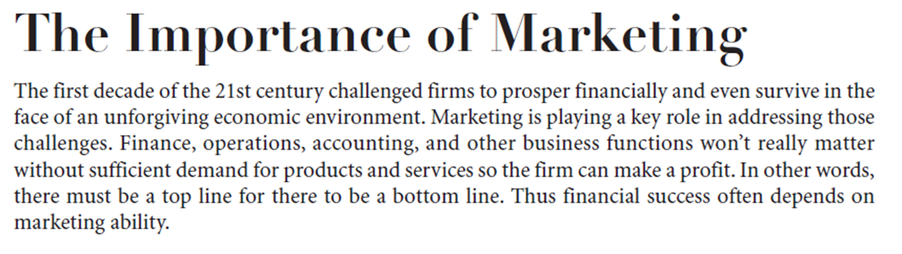
Megatrends in the future?
Technology and globalization.
Internet and more free trade.
Hyper-competition
Build in more differentiation
Customers - more educated
      The customer is King.

Slide 4
Marketing is an organizational function
A set of processes for
creating
communicating,
delivering value to customers
  satisfy the needs of a target market at a profit.
  Customer relationships
  benefit the organization and its stakeholders.
Identifying and meeting human and social needs.
“Meeting Needs Profitably.”
Notes:
Marketing is about identifying and meeting human and social needs. One of the shortest good definitions of marketing is “meeting needs profitably.”
The American Marketing Association offers the following formal definition: Marketing is the activity, set of institutions, and processes for creating, communicating, delivering, and exchanging offerings that have value for customers, clients, partners, and society at large.

Slide 5
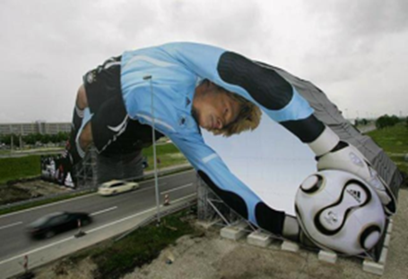
Marketing
?? Size of the identified market and the profit potential.
Pinpoints segments of serving best
Designs and promotes the appropriate products and services.
What is Marketed?
Goods
Services
Persons
Places
Organizations
Ideas

Slide 6
Marketing | Sales
Selling the idea of a product and/or service | Sells the product / service one-on-one, through media
Generates the interest | Brings in the money, get a agreement or contract.
Think strategically - direction over some period of time | Think tactically - actionable steps or decisions to follow the strategies established
Looking for ways and ideas, differentiate the product or service | Phone calls, outside sales setting up appointments to meet with the customer face-to-face
Most cases marketing exists to support the salespeople. | Persuade the reluctant buyer
Marketing Management: The Art and Science of choosing target markets Getting, keeping, and growing customers through creating, delivering, and communicating superior Customer Value. Building profitable relationships with Customers

Slide 7
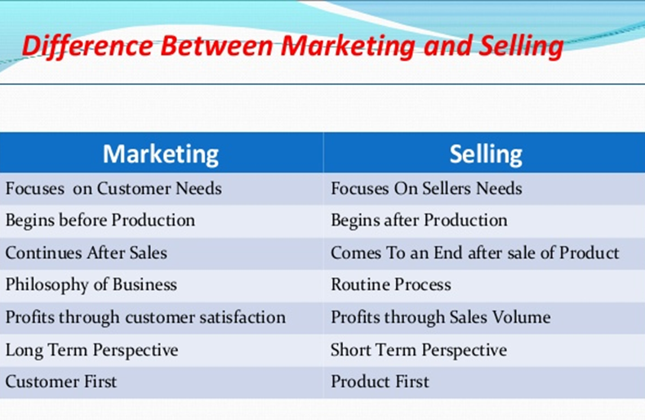



Slide 8
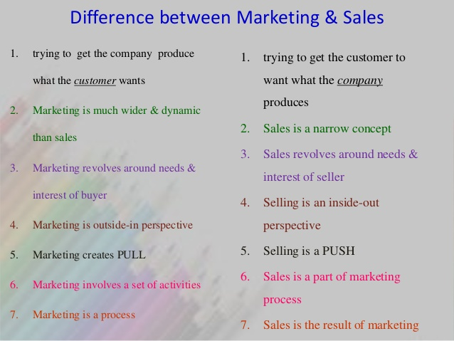



Slide 9
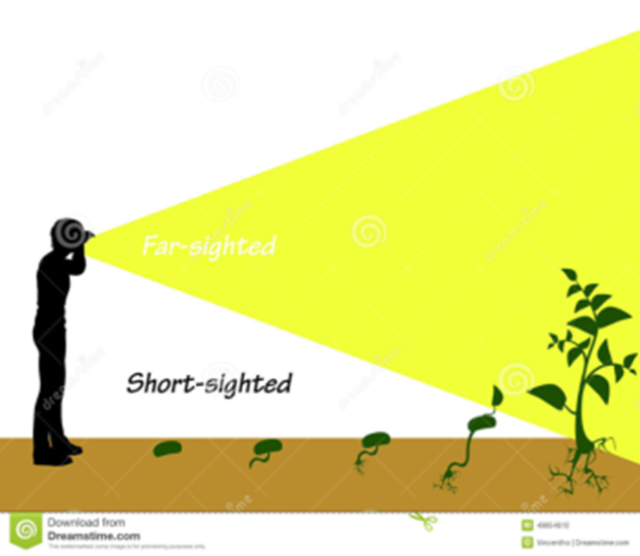
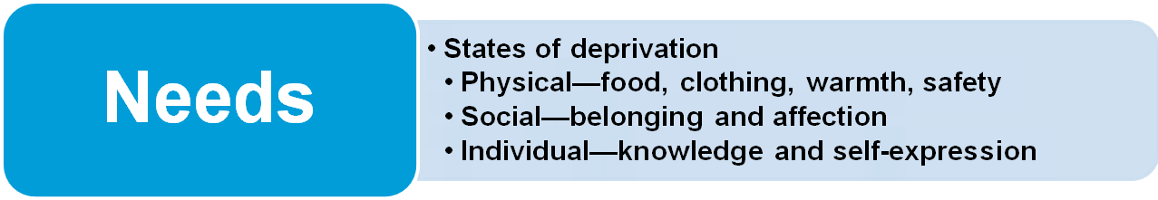
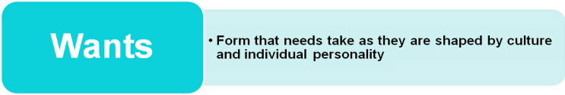
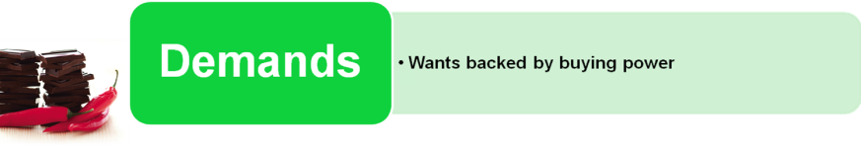
Marketing
Build strong customer relationships to capture value from customers in return
Marketing Myopia
focusing only on existing wants and losing sight of underlying consumer needs

Slide 10
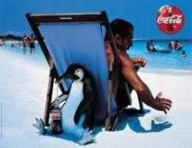
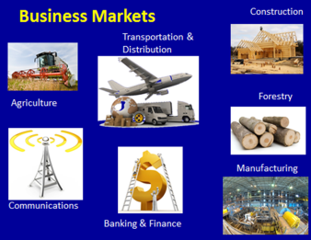
Key Customer Markets
Consumer Markets:
  mass consumer goods and services
  Establishing brand, availability, communications & reliable service.
Business Markets - Professional buyers
Organizations use goods and services in the production of other products or services
Agriculture, forestry, fisheries; mining; manufacturing; construction; banking
Notes:
Consumer Markets: Companies selling mass consumer goods and services spend a great deal of time establishing a strong brand image by developing a superior product and packaging, ensuring its availability, and backing it with engaging communications and reliable service.
Business Markets: Companies selling business goods and services often face well-informed professional buyers skilled at evaluating competitive offerings. Global Markets: Companies in the global marketplace must decide which countries to enter; how to enter each (as an exporter, licenser, joint venture partner, contract manufacturer, or solo manufacturer); how to adapt product and service features to each country; how to price products in different countries; and how to design communications for different cultures. They face different requirements for buying and disposing of property; cultural, language, legal and political differences; and currency fluctuations.
Nonprofit and Governmental Markets: Companies selling to nonprofit organizations with limited purchasing power such as churches, universities, charitable organizations, and government agencies need to price carefully.

Slide 11
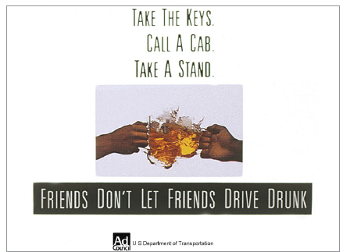
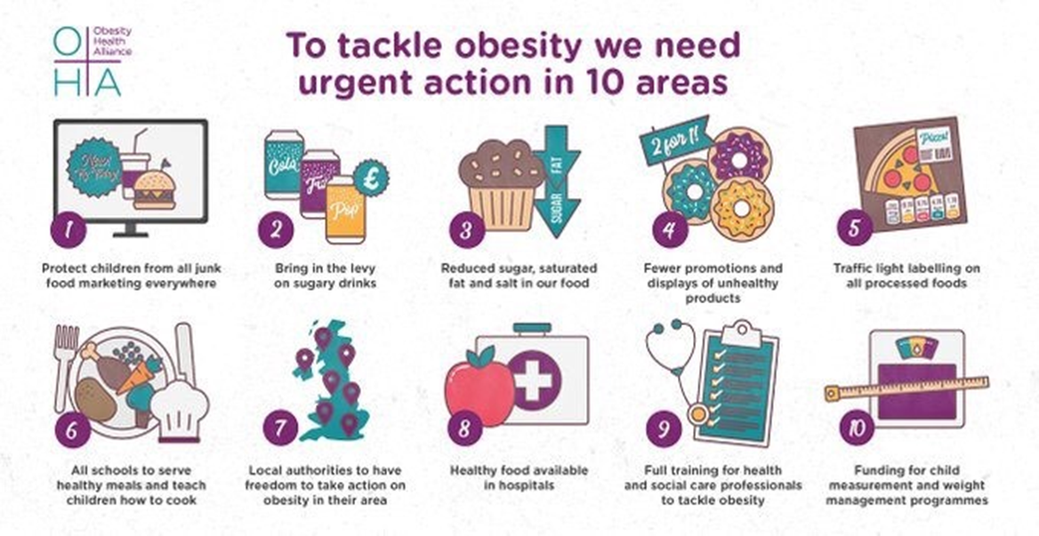
Global Markets
  Exporter, licenser, JV; adapt product and service; price, design.
Nonprofit and Governmental Markets
  Nonprofit organizations with limited purchasing power: universities, charitable organizations, government agencies etc.
Social Marketers do to promote socially desirable behaviors

Slide 12

Value and Satisfaction
The buyer chooses: the most value: tangible and intangible benefits
Value
  combination of Quality, Service, and Price (QSP) : the customer value triad.
  Value perceptions increase with quality and service but decrease with price.
  Marketing - identification, creation, communication, delivery, monitoring of customer value.
Satisfaction - performance in relationship to expectation.
Performance falls short – disappointed,
Matches – satisfied,
Exceeds them - customer is delighted
Notes:
Companies address customer needs by putting forth a value proposition, a set of benefits that satisfy those needs. The intangible value proposition is made physical by an offering, which can be a combination of products, services, information, and experiences.
A brand is an offering from a known source. A brand name such as McDonald’s carries many associations in people’s minds that make up its image: hamburgers, cleanliness, convenience, courteous service, and golden arches. All companies strive to build a brand image with as many strong, favorable, and unique brand associations as possible.

Slide 13
ရုပ္ဝတၳဳပစၥည္းတစ္ခုအေပၚမွာ လူသားတို႔ထားရွိတဲ့သေဘာထား (တန္ဖိုးထားမႈ) ဟာ အဲ့ဒီပစၥည္းနဲ႔ ဆက္ႏြယ္ ပတ္သတ္ေနတဲ့ (ရုပ္ဝတၳဳမဆိုင္တဲ့) အျခားအျခားေသာ အေၾကာင္းတရားေတြရဲ႕ ၾသဇာသက္ေရာက္မႈေအာက္မွာ ရွိေနတတ္လို႔ပါပဲ။
ဥပမာျပရရင္ Evian ဟာ ေရတစ္ေအာင္စကို ၁၅ ေဒးလာႏႈန္းနဲ႔ေရာင္းခ်ႏိုင္စြမ္းရွိပါတယ္။
စာသံုးသူမ်ားဟာ တစ္ေအာင္စကို ၂၅ ဆင့္သာ ထိုက္တန္တဲ့ Evian ရဲ႕ ပုလင္းသြင္းေသာက္ေရသန္႔အေပၚမွာ ဘာမွ အထြန္႔တတ္ေနၾကမွာမဟုတ္ပါဘူး။
Evian ဟာ စပေရးဘူးငယ္ေလးနဲ႔ ပက္ဖ်န္းရတဲ့ အလွဆီတမ်ိဳးကိုလဲ ၁၅ေဒၚလာနဲ႔ပဲေရာင္းခ်ပါတယ္။
အဲ့ဒီဘူးထဲမွာလဲ ေရအဓိကပါဝင္တာျဖစ္ေပမဲ့ ပူေလာင္အိုက္စပ္တဲ့ေနမ်ိဳးမွာ သံုးစြဲသူရဲ႕မ်က္ႏွာေပၚပက္ဖ်န္းျခင္းအားျဖင့္ ျပန္လည္လန္းဆန္းလာေစပါတယ္။
ကုန္အမွတ္တံဆိပ္ေတြအၾကား ကြာဟတဲ့တန္ဖိုးကို ခန္႔မွန္းတြက္ခ်က္ၾကည့္တဲ့အခါမွာ ကိုကာကိုလာရဲ႕ ကုန္အမွတ္တံဆိပ္အမည္ (Brand Name) သက္သက္ဟာ ေဒၚလာ ၃၅ ဘီလီလ်ံတန္ဖိုးရွိတာကိုေတြ႔ရွိရပါတယ္။
တကယ္ေတာ့အဲ့တန္ဖိုးဟာ ကိုကာကိုလာ ထုတ္လုပ္တဲ့စက္ရုံေတြ စုစုေပာင္းတန္ဖိုးထက္ေတာင္ ပိုမိုမ်ားျပားေနပါေသးတယ္။

Slide 14
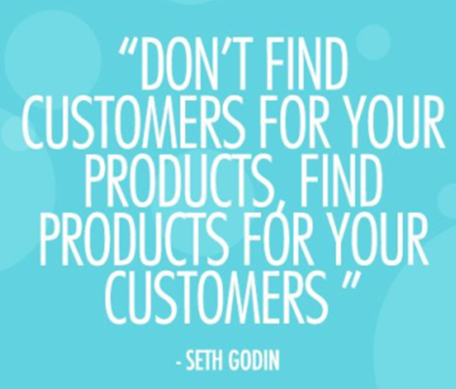
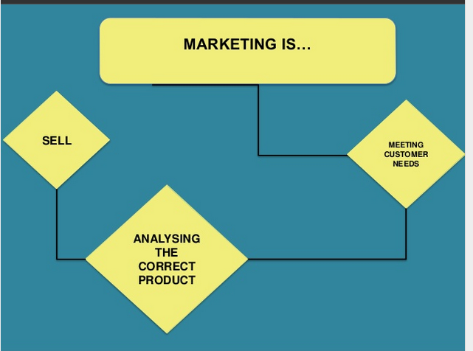

Slide 15
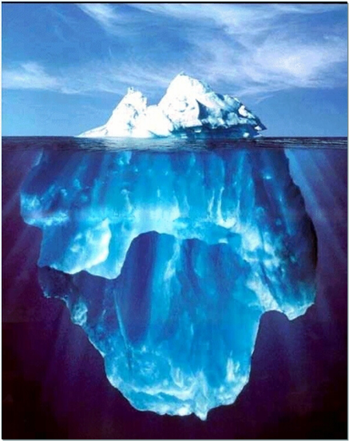
Understanding vs. Consumer Insights
Understanding
Consumers’ observable behavior and attitudes.
Insights
Consumers’ thoughts, habits and feelings and affect on behavior and decisions

Slide 16
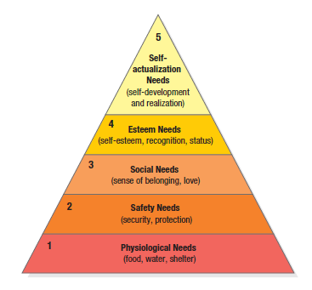
1). Maslow’s Hierarchy of Needs
Motivation
2). Freud’s Theory – Behavior is
guided by Subconscious motivations
3). Herzberg’s Two- Factor Theory
Behavior is guided by motivating
and hygiene factors
Behavior is driven by the lowest, unmet need
To satisfy most important need first, then to satisfy next most important.
A starving man (1) not interest in the latest happenings in the art world (5), nor in how he is viewed by others (3 or 4), nor whether breathing clean air (2)
when enough food and water, the next most important need will become salient.
Notes:
The slide illustrates Maslow’s Need Hierarchy. The theory suggests that people will try to satisfy their most important need first and then try to satisfy the next most important. For example, a starving man (need 1) will not take an interest in the latest happenings in the art world (need 5), nor in how he is viewed by others (need 3 or 4), nor even in whether he is breathing clean air (need 2), but when he has enough food and water, the next most important need will become salient.

Slide 17
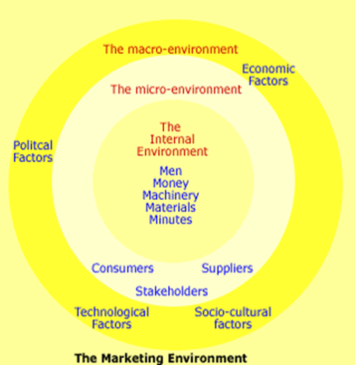
Macro Environment
Political
Economic
Social And Cultural
Technological
Natural
Demographic
Demography – Populations, density, location, age, gender, race, occupation,
Generational marketing - Segmenting people by lifestyle of life state instead of age
  Baby boomers - born between 1946 and 1964
  Generation X - born between 1965 and 1976
    Cautious economic outlook, Less materialistic, Family comes first
    Millennial (gen Y or echo boomers)- 1977and 2000
  Comfortable with technology, Tweens (8–12), Teens (13–19), Young adults (20’s)

Slide 18
မက္ခရိုပတ္ဝန္းက်င္
အစဥ္သျဖင့္ေျပာင္းလဲေနတဲ့ မက္ခရိုပတ္ဝန္းက်င္ထဲမွာ ေရတြက္လို႔မရႏိုင္ေလာက္ေအာင္မ်ားျပားတဲ့ အခြင့္
အလမ္းေတြေပၚထြက္ေနပါတယ္။
တိမ္းညြတ္ရာရွာေဖြမႈလုပ္ငန္းစဥ္ (Trand – spotting) မွာ က်ြမ္းက်င္မႈျပည့္ဖို႔လိုအပ္ပါသည္။
(၁) ဝန္ေဆာင္မႈမ်ား (Service ) ကိုထည့္သြင္းမစဥ္းစားေတာ့ဘူးလား ?
(၂) ထုတ္ပိုးမႈ (Packaging) ကို ထည့္သြင္းမစဥ္းစားေတာ့ဘူးလား ? စားသံုးသူေစ်းကြက္ေဖာ္ေဆာင္ျခင္း
(Consumer Marketing ) မွာ ထုတ္ပိုးမႈဟာ ေသာ့ခ်က္က်တဲ့ ယွဥ္ျပိဳင္ေရး အစိတ္အပိုင္း (Competitive
Element) တစ္ခုမဟုတ္ဘူးလား?
(၃) တစ္ဦးခ်င္းေတြ႔ဆံုေရာင္းခ်ျခင္း (Personal Selling)
ABC Accounting လို႔ေခၚတဲ့ လုပ္ေဆာင္ခ်က္အေျချပဳ တန္ဖိုးတြက္စာရင္းကိုင္စနစ္(Activity Based Costing)
ကိုအသံုးျပဳ တြက္ခ်က္ အျမတ္တင္မႈ (Markup) တစ္ခုကို ေဆာင္းထည့္ေလ့ရွိပါတယ္။
အဲ့ဒါကို ကုန္က်စရိတ္အေျချပဳေစ်းနႈန္း
သတ္မွတ္မႈ (Cost – based Pricing ) လို႔ေခၚပါတယ္။
အျခားတစ္ဖက္မွာေတာ့ ကုမၸဏီတခ်ိဳ႕ဟာ တန္ဖိုးအေျချပဳေစ်းႏႈန္းသတ္မွတ္မႈ (Value – based Pricing)
ကိုက်င့္သံုးၾကပါသည္။

Slide 19
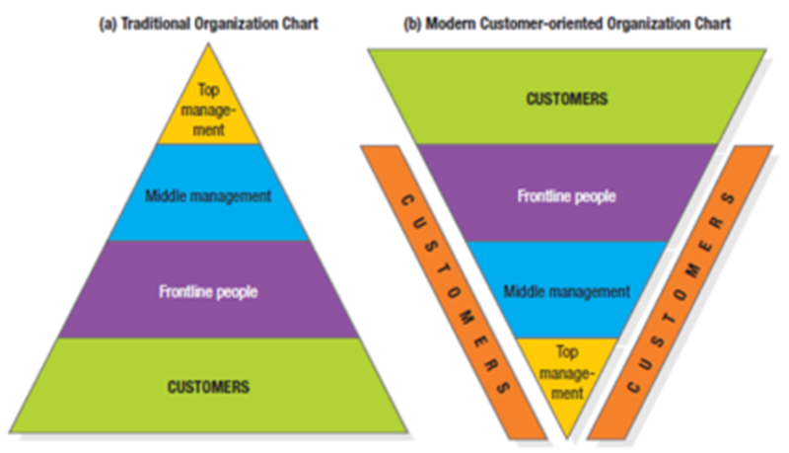
Internal Environment
ျဗိတိန္ႏိုင္ငံရဲ႕ အေကာင္းဆံုး ကုန္စည္လက္လီေရာင္းခ်ေရး ကုမၸဏီၾကီးျဖစ္တဲ့ Mark & Spencer မွာ ေစ်းကြက္ေဖာ္ေဆာင္ေရးဌာနရယ္လို႔ သီးသန္႔မရွိေသးပါဘူး။
သို႔ေပမဲ့ ဝန္ထမ္းတိုင္ဟာ ေဖာက္သည္ေတြကို ပထမဦးစားေပးအျဖစ္ ခံယူက်င့္သံုးခဲ့တာေၾကာင့္ အဲ့ဒီကုမၸဏီဟာ လံုးဝေၾကာ္ျငာစရာမလိုတဲ့အျပင္ စြဲစြဲျမဲျမဲသစၥာရွိရွိအားေပးေနၾကတဲ့ ေဖာက္သည္အုပ္စုၾကီးကို ယေန႔ထက္တိုင္ ဆြဲေဆာင္ထိန္းသိမ္းထားႏိုင္ဆဲျဖစ္ပါတယ္။
ေဖာက္သည္ေတြဆီကရရွိတဲ့ တံု႔ျပန္သေဘာထား (Feed – back)
​အေပၚအေျခခံျပီး ထုတ္ကုန္ကို စဥ္ဆက္မျပတ္ အရည္အေသြးျမွင့္တင္ေနပါတယ္။
“Employee autonomy — “using your best judgment”

Slide 20
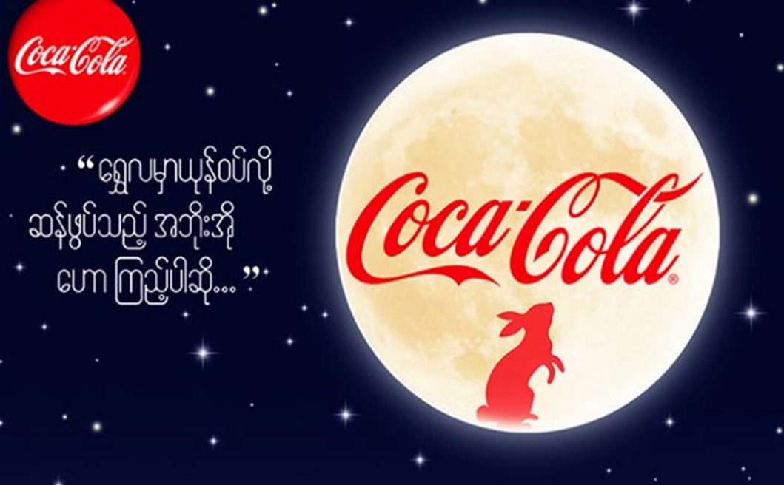


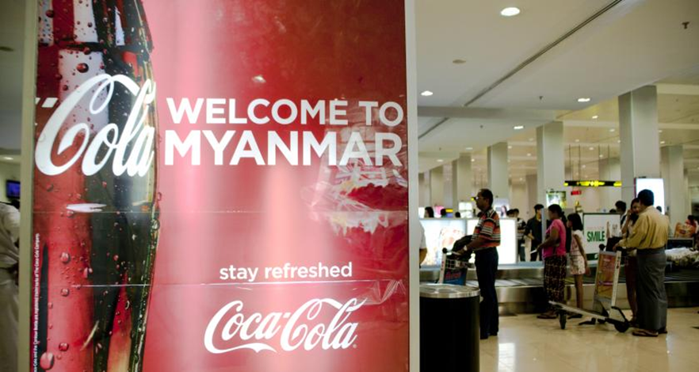

Slide 21
Seven Functions of Marketing
Distribution
Shop in the part of a city?? Interconnected world
Financing
Creation and advertising of your goods or services.
Market Research
Information about target customers
Who? Why? On-the-ground observation trends and competing products.
Pricing
Too high -- lose customers -- too low--- robbing profits
Product and Service Management
Listening to customers, responding to wants and needs keeping fresh up to date.
Promotion
Tailoring promotion messages to new media ( Facebook --), outlets
Selling
Only after determined the wants and needs , Right products at the right price

Slide 22
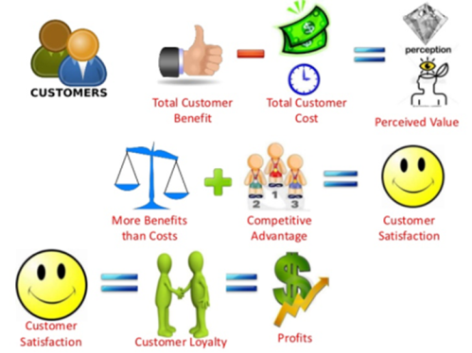
Major Steps in Effective Selling
Tells the product “story” to the buyer
Follow the AIDA formula :
  Gaining attention
  Holding interest
  Arousing desire
  Obtaining action
Prospecting and Qualifying
Pre approach
Approach
Presentation
and Demonstration
Overcoming
objections
Closing
Follow up
and Maintenance

Slide 23
Communication Skills
F
A
B
the product, promotion or service itself or a specific characteristic of these
F
eature
explains the meaning of the feature or the reason why it’s important
A
dvantage
describes how the feature and advantage meet the customer’s needs
B
______

Slide 24
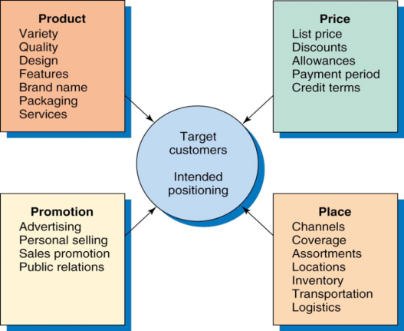
Integrated Marketing Plan
Marketing mix: (4 Ps) to implement marketing strategy.
Integrated marketing program:
  comprehensive plan that communicates and delivers the intended value to chosen customers.
4 P’s - Seller’s View
  Product
  Price
  Place
  Promotion
4 C’s - Buyer’s View
  Customer Solution
  Customer Cost
  Convenience
  Communication

Slide 25
Marketing Mix
For the target customer
4 Ps (Seller’s Mind Set)
Product (Configuration)
Price (Valuation)
Place (Facilitation) &
Promotion (Symbolization)
4 Cs (Buyer’s Mind Set)
Customer value (not product)
Customer Costs (not price)
Convenience (not place)
Communication (not promotion)
“Sellers should first work with 4Cs before setting the 4Ps

Slide 26
ေဈးကြက္ေဖာ္ေဆာင္ေရး အေရာအႏွာ (Marketing Mix)
ထုတ္ကုန္ရဲ႕ ေနရာယူမႈကို ပံ့ပိုးျခင္းနဲ႔ လႊဲေျပာင္းျခင္းတို႔ ျပဳေပးႏိုင္ေစဖို႔ ေစ်းကြက္အေရာအေႏွာမွာ
ပာဝင္တဲ့ လက္နက္ကိရိယာေတြ (Tools) ကို တပ္ဆင္ေရးအတြက္ နည္းဗ်ဴဟာေျမာက္ ေစ်းကြက္ေဖာ္ေဆာင္ မႈအဆင့္ (Tactical Marketing Stage ) ကို ေရြ႕ေျပာင္းရမွာျဖစ္ပါတယ္။ လက္နက္ကိိရိယာေတြဟာ ‘ပီ’ ေလးလံုးအျဖစ္နဲ႔လူသိမ်ားပါတယ္။
(၁) ထုတ္ကုန္ (Product) - ေစ်းကြက္ထဲက ရရွိႏိုင္တဲ့ အထူးသျဖင့္ ‘ကိုင္တြယ္ထိေတြ႔လို႔ရတဲ့ ထုတ္ကုန္’၊
‘ထုတ္ပိုးမႈ’ နဲ႔ ‘ဝယ္ယူရာမွာ ဝယ္သူအလိုရွိလာႏိုင္တဲ့ ဝန္ေဆာင္မႈတစ္စံု။’
(၂) ေစ်းႏွဳန္း (Price) - လႊဲေျပာင္းေပးပို႔ျခင္း၊ အာမခံေပးျခင္းတို႔လို တျခားကုန္က်စရိ္တ္ေတြ ပူးေပါင္းပါဝင္တဲ့ ထုတ္ကုန္ရဲ႕ေစ်းႏႈန္း။
(၃) ေနရာ သို႔မဟုတ္ ျဖန္႔ခ်ီျခင္း (Place or Distribution ) - ထုတ္ကုန္ကို အဆင္သင့္ဝယ္ယူရရွိႏိုင္ေအာင္နဲ႔ ပစ္မွတ္ေစ်းကြက္ဆီအေရာက္ပို႔ႏိုင္ေအာင္စီစဥ္မႈမ်ား။
(၄) ျမွင့္တင္ျခင္း (Promotion) - ပစ္မွတ္ေစ်းကြက္ကို ထုတ္ကုန္ရဲ႕ရရွိႏိုင္မႈနဲ႔ ထုတ္ကုန္ကေပးစြမ္းႏိုင္တဲ့ အက်ိဳးေက်းဇူးမ်ားအေၾကာင္းကို အသိေပးဆြဲေဆာင္ဖို႔ သို႔မဟုတ္ သတိေပးဖို႔အတြက္ ေၾကာ္ျငာျခင္း၊
အေရာင္းျမွင့္တင္ျခင္း၊ စာတိုက္မွတစ္ဆင့္ တိုက္ရိုက္အသိေပးျခင္းနဲ႔ လူထုသိရွိေအာင္ လုပ္ေဆာင္ျခင္းတို႔လို ဆက္သြယ္မႈဆိုင္ရာလုပ္ေဆာင္ခ်က္မ်ား။

Slide 27
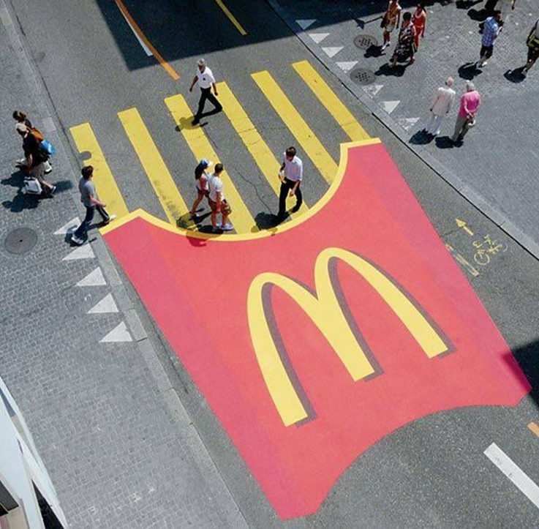
The New Four Ps
People - internal marketing: critical to marketing success.
Processes- creativity, discipline, and structure
Programs - consumer-directed activities, encompasses the old four Ps
Performance- outcome measures: financial and nonfinancial, brand
Notes:
If we update them to reflect the holistic marketing concept, we arrive at a more representative set that encompasses modern marketing realities: people, processes, programs, and performance, as in Figure 1.5.
People reflects, in part, internal marketing and the fact that employees are critical to marketing success.
Processes reflects all the creativity, discipline, and structure brought to marketing management. Programs reflects all the firm’s consumer-directed activities. It encompasses the old four Ps as well as a range of other marketing activities that might not fit as neatly into the old view of marketing.
We define performance as in holistic marketing, to capture the range of possible outcome measures that have financial and nonfinancial implications (profitability as well as brand and customer equity), and implications beyond the company itself (social responsibility, legal, ethical, and community related).

Slide 28
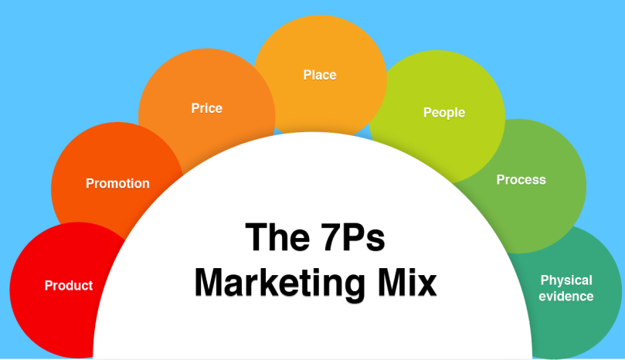
Strategic Planning
Process of Developing and Maintaining a Strategic Fit Between the Organization’s Goals and Capabilities and
Its Changing Marketing Opportunities.

Slide 29
ေစ်းကြက္ေဖာ္ေဆာင္မႈဆက္သြယ္ေရးဆိုင္ရာ လက္နက္ကိရိယာ (Marketing Communication Tools) ကို သမူဟျပဳေပာင္းစပ္ေပးျခင္းထက္ ဆက္သြယ္ေရးလက္နက္ကိရိယာ တစ္ခုခ်င္းစီအတြက္ သီျခားစီ အစီအစဥ္ခ်မွတ္ေဆာင္ရြက္ျခင္း။ XXXXX
ေဖာက္သည္ေတြရဲ႕ အမွန္တကယ္လိုအပ္ခ်က္ကို (Customer’s Real Needs) ကို နားလည္သိရွိဖို႔နဲ႔ ျဖည့္ဆည္းေပးဖို႔အားထုတ္ျခင္းထက္ ထုတ္ကုန္ေရာင္းခ်ရေစေရးကိုသာ ဦးစားေပးလုပ္ေဆာင္ျခင္း။XXXXX
Loyalty – re-buy or re-patronize a preferred product or service in future
Customer Equity - Total combined customer lifetime values of all of the company’s customers

Slide 30
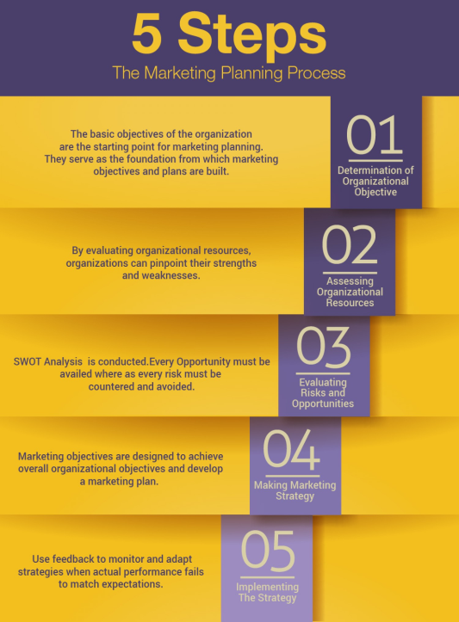
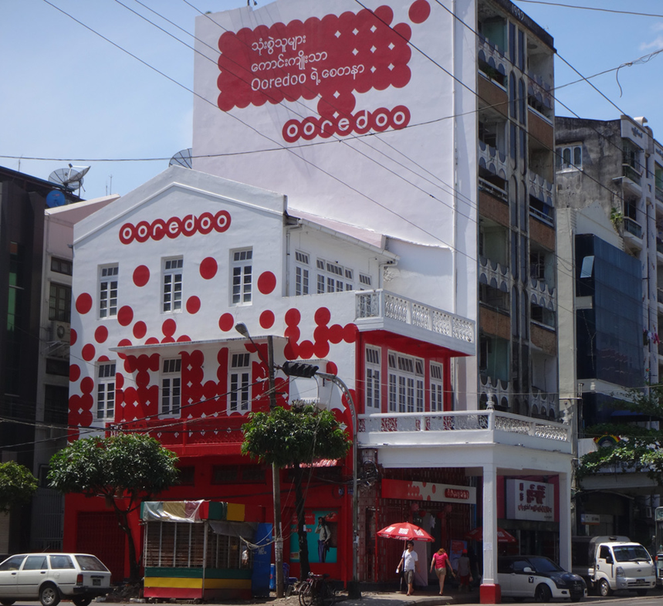

Slide 31
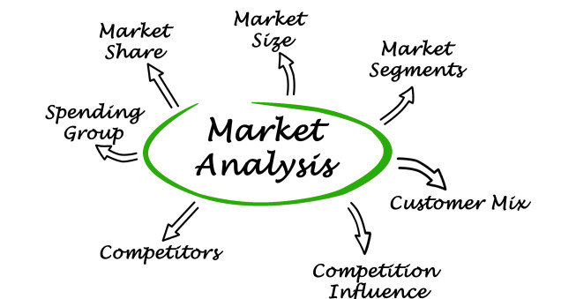
SWOT သရုပ္ခြဲဆန္းစစ္မႈ
SW (Strength and Weakness) နဲ႔ OT (Opportunity
and Threat) ဆိုတဲ့ စာရင္းႏွစ္ခုျပဳစုရပါတယ္။
SWက ကုမၸဏီနဲ႔သူရဲ႕ထုတ္ကုန္တို႔ရဲ႕ အဓိကအားနည္းခ်က္တို႔
ကိုေဖာ္ျပျပီး
OT ကပဓာနက်တဲ့ အခြင့္အလမ္းနဲ႔ျခိမ္းေျခာက္မႈေတြကို ေဖာ္ျပပါတယ္။ SW ကကုမၸဏီအတြင္း ပိုင္းမွာရွိတဲ့ အင္အားစုေတြ (Forces ) ကိုေဖာ္ျပပါတယ္။

Slide 32
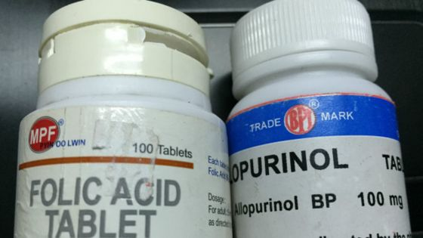
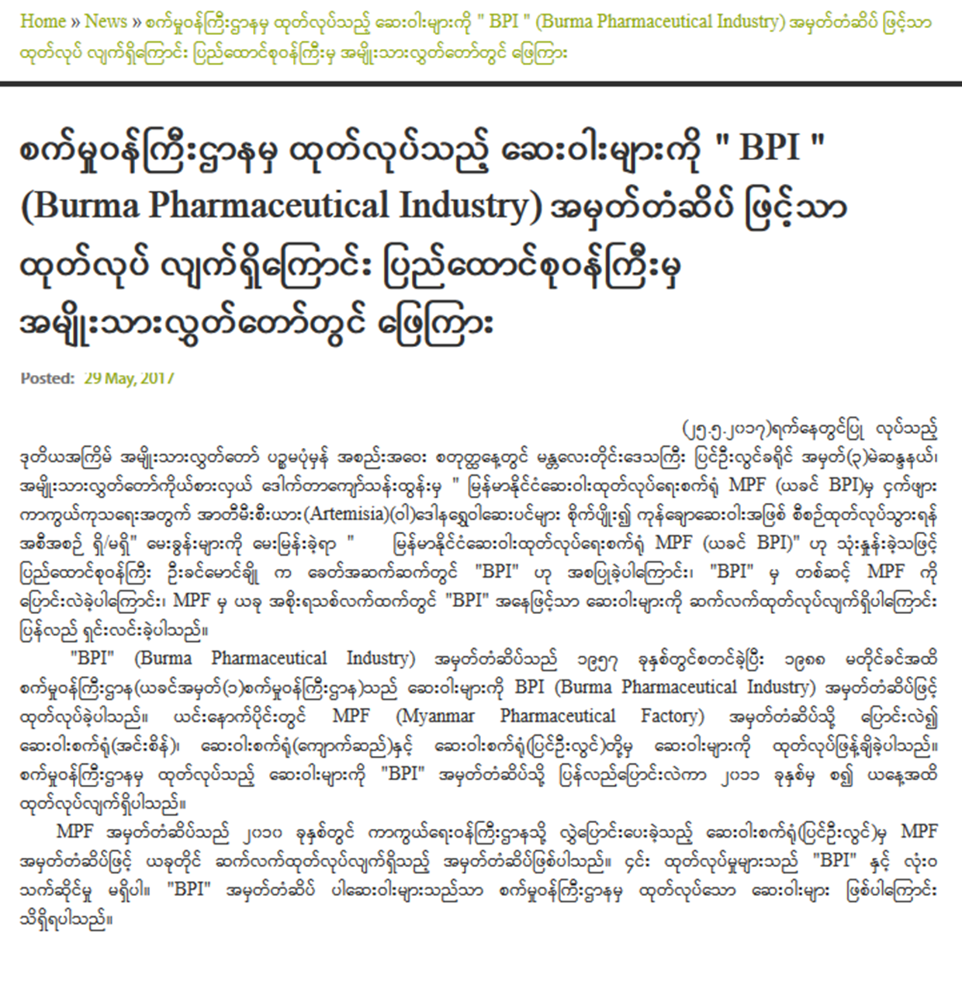

Slide 33
မဟာဗ်ဴဟာေရြးခ်ယ္ျခင္း
ပစ္မွတ္ေစ်းကြက္- (Target Market )
ပဓာနေနရာယူမႈ (Core Position )
ေစ်းႏႈန္းေနရာယူမႈ (Price Positioning) ၊
အလံုးစံုတန္ဖိုးကမ္းလွမ္းခ်က္ (Total Value Proposition)
ျဖန္႔ခ်ီေရးမဟာဗ်ဴဟာ (Distribution Strategy)၊
ဆက္သြယ္ေရးမဟာဗ်ဴဟာ (Communication Strategy)

Slide 34
ေစ်းကြက္ေဖာ္ေဆာင္ေရး စီမံကိန္းတစ္ခုမွာ ဘာေတြပါဝင္သင့္ပါသလဲ
ပန္းတိုင္ေတြ (Goals) ၊ မဟာဗ်ဴဟာ (Strategy)နဲ႔ ကုန္က်စရိတ္ (Cost) တို႔ကို သိလိုၾကတာပါ။
ေစ်းကြက္ေဖာ္ေဆာင္ေရးစီမံကိန္းတိုင္းမွာ အနည္းဆံုးအားျဖင့္ ေအာက္ေဖာ္ျပအခန္းက႑ေတြပါဝင္
ရပါမယ္။
အေျခအေနသရုပ္ခြဲဆန္းစစ္ျခင္း (Situation Analysis)
ေစ်းကြက္ေဖာ္ေဆာင္ေရး ရည္မွန္းခ်က္မ်ားနဲ႔ပန္းတိုင္မ်ား (Marketing Objectives and Goals )
ေစ်းကြက္ေဖာ္ေဆာင္ေရးမဟာဗ်ဴဟာ (Marketing Strategy)
ေစ်းကြက္ေဖာ္ေဆာင္ေရးလႈပ္ရွားမႈစီမံကိန္း ( Marketing Action Plan)
ေစ်းကြက္ေဖာ္ေဆာင္ေရးဆိုင္ရာထိန္းခ်ဳပ္မႈမ်ား (Marketing Controls)

Slide 35
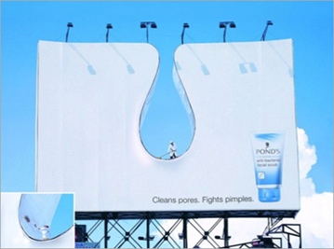
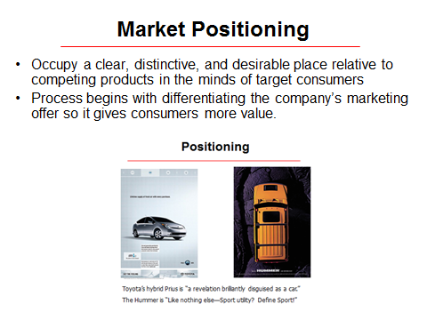
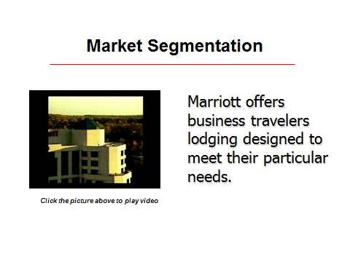
Customer-Driven Marketing Strategy- STP
Market Segmentation
division of a market into distinct groups of buyers
distinct needs, separate products, marketing mixes
Market Targeting - evaluating each segment’s attractiveness, selecting one or more segments

Slide 36
Not everyone the same, dividing the market into Segments
Identify and profile distinct groups of buyers
  demographic, psychographic, and behavioral differences
Decides which present the greatest opportunities - Target markets.
Develops a market offering that it Positions in the minds of the target buyers as delivering some central benefit(s).

Slide 37
ေစ်းကြက္ေဖာ္ေဆာင္ေရးစီမံခန္႔ခြဲ၏ ပဓာနက်ေသာအဆင့္မ်ား
R => STP => MM => I=> C
R (Research ) = သုေတသန (ဥပမာ - ေစ်းကြက္သုေတသန)
STP (Segmentation , Targeting and Positioning ) = ပိုင္းျခားစိတ္ျဖာျခင္း၊ ရည္ရြယ္ပစ္မွတ္ျခင္းႏွင့္ ေနရာယူျခင္း
MM (Marketing Mix) = ေစ်းကြက္ေဖာ္ေဆာင္ေရး အေရာအေႏွာ
[ပီေလးလံုးလို႔ လူသိမ်ားတဲ့ ထုတ္ကုန္ (Product) ၊ တန္ဖိုး (Price)၊ ေနရာ (Price)၊ ျမွင့္တင္ျခင္း (Promotion)]
I (Implementation) = အေကာင္အထည္ေဖာ္ေဆာင္ရြက္ျခင္း၊
C (Control) = ထိန္းခ်ဳပ္ျခင္း (တံု႔ျပန္သေဘာထား ျပန္လည္ရယူျခင္း၊ ရလဒ္မ်ားကို အကဲျဖတ္ျခင္း + STP မဟာဗ်ဴဟာတို႔ကို ျပန္လည္မြမ္းမံျပင္ဆင္ျခင္း သို႔မဟုတ္ ျမွင့္တင္ျခင္း)

Slide 38
ပိုင္းျခားစိတ္ျဖာျခင္း၊ ပစ္မွတ္ထားျခင္းနဲ႔ ေနရာယူျခင္း
(Segmentation, Targeting, and Positioning)
‘ဒီအဆင့္ကို မဟာဗ်ဴဟာေျမာက္ ေစ်းကြက္ေဖာ္ေဆာင္ျခင္း (Strategic Marketingလို႔ လည္းေခၚဆိုသတ္မွတ္ ႏိုင္ပါတယ္။
ေစ်းကြက္အစိတ္အပိုင္း တစ္ခုခ်င္းဆီမွာ ေအာင္ျမင္မႈရရွိဖို႔လိုအပ္တဲ့ စြမ္းေဆာင္ရည္မ်ားနဲ႔ မိမိမွာတည္ရွိေနတဲ့ စြမ္းေဆာင္ရည္မ်ားကို တိုက္ဆိုင္ဆန္းစစ္ျခင္းအားျဖင့္ ကုမၸဏီတခုဟာာ ပစ္မွတ္အစိ္တ္အပိုင္းေတြကို ပိုမိုလိမၼာပါးနပ္စြာ ေရြးခ်ယ္နိုင္ပါတယ္။
ေရာင္းခ်သူေတြဟာ ဝယ္ယူရန္အလားအလာရွိသူေတြကို ‘ ေသာ့ခ်က္က်ေသာအက်ိဳးေက်းဇူး’ အျပင္
သူတို႔ရဲ႕ကုန္အမွတ္တံဆိပ္ကိုေတြ ဝယ္ယူသင့္ေၾကာင့္ ေနာက္ထပ္အေၾကာင္းျပခ်က္မ်ား’ ကိုပါတင္ျပပါလိမ့္မယ္။
ကုန္အမွတ္တံဆိပ္တစ္ခုဟာ အဓိကပင္မ ဂုဏ္အဂၤါ သို႔မဟုတ္ အက်ိဳးေက်းဇူးတစ္ခုတည္းအေပၚမွာသာ ထီးထနရီး ောမယူဘဲ ပိုမိုျပည့္ဝတဲ့ေနရာယူမႈကိုပါ သယ္ေဆာင္လာပါတယ္။

Slide 39
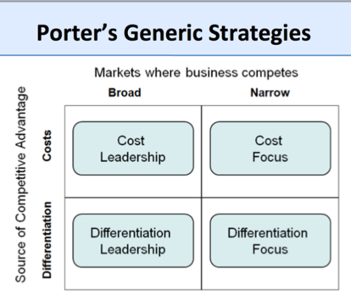
Competitive Advantage
Main challenge for business strategy
A sustainable competitive advantage over the other competing products and firms in a market.
Offering consumers greater value: lower prices or greater benefits and service that justifies higher prices.

Slide 40
ေယဘုယ်ေနရာယူမႈတစ္ရပ္ကို ေရြးခ်ယ္ျခင္း (Choosing a Broad Positioning )
Business Unit ယူနစ္တစ္ခုဟာ
(၁) အမ်ားနဲ႔မတူ တမူထူးျခားစြာ ထုတ္လုပ္သူ (Product Differentiator) (သို႔)
(၂) ကုန္က် စရိတ္အနည္းဆံုးနဲ႔ ထုတ္လုပ္ႏိုင္သူ (Low Cost Leader ) (သို႔)
(၃) အမ်ားသတိမမူမိတဲ့
အခြင့္အလမ္းေကာင္းေတြကို ရယူေဆာင္ရြက္သူ (Nicher ) အျဖစ္ ေဆာင္ရြက္ႏိုင္ေၾကာင္း ေရြးခ်ယ္ စရာ နည္းလမ္းသံုးသြယ္ကို သူ႔ရဲ႕ ယွဥ္ျပိဳင္ေရးမဟာဗ်ဴဟာ (Competitive Strategy) ျဖင့္ ေစ်းကြက္ထဲမွာ ေနရာယူၾကပါတယ္။
အဲ့ဒါကို တစ္ခုတည္းေသာ အဓိကအက်ိဳးေက်းဇူးအေၾကာင္းျပဳေနရာယူမႈ (Single Major Benefit Positioning) လို႔ေခၚပါတယ္။
(၁) အေကာင္းဆံုးအရည္အေသြး။
(၂) အေကာင္းဆံုးစြမ္းေဆာင္ႏိုင္မႈ။
(၃) မွီခိုအားထားရမႈအရွိဆံုး။
(၄) ေရရွည္အခံဆံုး။
(၅) လံုျခံဳစိတ္ခ်ရမႈအရွိဆံုး။
(၆) အလ်င္ျမန္ဆံုး။
(၇) ကုန္က်ခံရတဲ့ေငြေၾကးအတြက္ ထိုက္တန္မႈအရွိဆံုး။
(၈) ကုန္က်စရိတ္ အသက္သာဆံုး။
(၉) ဂုဏ္ျဒပ္အရွိဆံုး။
(၁၀) ဒီဇိုင္း သို႔မဟုတ္ စတိုင္လ္အေကာင္းဆံုး။
(၁၁) သံုးစြဲဖို႔အလြယ္ကူဆံုး။
(၁၂) သံုးစြဲရာမွာ အဆင္အေျပဆံုး။

Slide 41
ဒါ့ေၾကာင့္လည္း ေမာ္ေတာ္ယာဥ္ေစ်းကြက္ထဲမွာ မာစီဒီးက ဂုဏ္ျဒပ္အရွိဆံုး၊ ဘီအမ္ဒဗလ်ဴက ေမာင္းႏွင္မႈစြမ္းေဆာင္ရည္အရွိဆံုး၊ ဟြန္ဒိုင္းက ကုန္က်စရိတ္ အသက္သာဆံုး၊
Volvo က လံုျခံဳစိတ္ခ်မႈအရွိဆံုး ဆိုျပီး ေနရာ အသီးသီးယူထားၾက။
၀ယ္ယူသူေတြကေတာ့ ထုတ္ကုန္တစ္ခုအေပၚ သူေပးလိုက္ရမယ့္ ေငြေၾကးပမာဏတန္ဖိုးနဲ႔ အဲ့ဒီထုတ္ကုန္က ေပးမယ့္ အက်ိဳးေက်းဇူးတို႔ထိုက္တန္ျခင္း ရွိ၊ မရွိကို ထည့္သြင္းစဥ္းစားမွာေသခ်ာပါတယ္။
ဒါေၾကာင့္ ေရာင္းခ် သူဟာ သူ႔ရဲ့ကုန္အမွတ္တံဆိပ္အတြက္ တန္ဖိုးေနရာ (Value-Position) တစ္ခုရေအာင္ လုပ္ေဆာင္ရပါလိမ့္ မယ္။
အဲဒီ့ေနာက္ ၀ယ္ယူဖို႔အလားအလာရွိသူဟာ သူထည့္သြင္းစဥ္းစားတဲ့ ထုတ္ကုန္အမွတ္တံဆိပ္အသီးသီးရဲ႔
“အလံုးစံုကမ္းလွမ္းခ်က္” နဲ႔ “ အလံုးစံုကုန္က်စရိတ္” တို႔ရဲ႕ ျခားနားခ်က္ သို႔မဟုတ္ အခ်ိဳးအစားကို ဆန္းစစ္မႈ
ျပဳရပါတယ္။ ဝယ္ယူဖို႔အလားအလာရွိသူဟာ သူ႕အေပၚဆြဲေဆာင္မႈအရွိဆံုး အလံုးစံုတန္ဖိုးကမ္းလွမ္းခ်က္
(Total Value Proposition) ကိုေပးစြမ္းႏိုင္မယ့္ ကုန္ပစၥည္းေပးသြင္းသူကိုသာ ေရြးခ်ယ္မွာ ေသခ်ာပါတယ္။

Slide 42
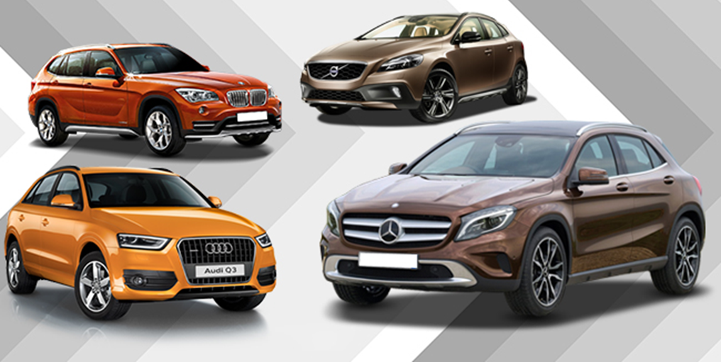
Value proposition
Set of benefits or values promises to deliver to customers to satisfy their needs
More than core positioning of offering.
Establishing Value
Volvo’s - “safety,” is promised more than just a safe car; other benefits- good performance, design, and safety
Good Value delivery system
  experiences the customer will obtain and using the offering.
  a set of core business processes that help deliver distinctive consumer value.
Notes:
Not everyone likes the same cereal, restaurant, college, or movie. Therefore, marketers start by dividing the market into segments. They identify and profile distinct groups of buyers who might prefer or require varying product and service mixes by examining demographic, psychographic, and behavioral differences among buyers.
After identifying market segments, the marketer decides which present the greatest opportunities— which are its target markets. For each, the firm develops a market offering that it positions in the minds of the target buyers as delivering some central benefit(s).

Slide 43
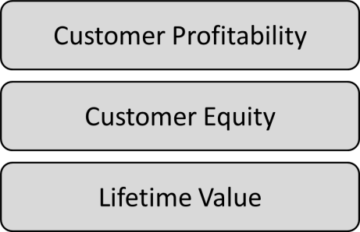
Maximizing
Customer Lifetime Value
Quality - totality of features and characteristics of a product or
service that bear on its ability to satisfy stated or implied needs.
Satisfaction depends on product and service quality.
“fitness for use,” “freedom from variation.”
Seller has delivered quality whenever meets or exceeds the customers’ expectations.
A company that satisfies customers’ needs most of the time is called a quality company
Notes:
Satisfaction will also depend on product and service quality. What exactly is quality? Various experts have defined it as “fitness for use,” “conformance to requirements,” and “freedom from variation.” We will use the American Society for Quality’s definition: Quality is the totality of features and characteristics of a product or service that bear on its ability to satisfy stated or implied needs. This is clearly a customer-centered definition. We can say the seller has delivered quality whenever its product or service meets or exceeds the customers’ expectations. A company that satisfies most of its customers’ needs most of the time is called a quality company, but we need to distinguish between conformance quality and performance quality (or grade).

Slide 44
ေစ်းကြက္ေဖာ္ေဆာင္ေရးကိုကုန္စည္ေရာင္းခ်ေရးနဲ ့တန္းတူ သေဘာတူ ထားျခင္း။
လက္ရွိေဖာက္သည္ေတြကိုအေလးထားဂရုျပဳထိမ္းသိမ္းထားတာထက္ ေဖာက္သည္အသစ္ရွာေဖြမႈအေပၚအေလးထားျခင္း။
ေဖာက္သည္တို႔ရဲ႕ ဘဝတစ္သက္သာ တန္ဖိုးထားမႈ (customer Life Time Value ) ျဖစ္ေပၚလာေအာင္ စီမံေဆာင္ရြက္မႈက တစ္ဆင့္ အျမတ္အစြန္းရရွိေအာင္ အားထုတ္ျခင္းထက္ အေရာင္းအဝယ္ လုပ္ေဆာင္ခ်က္တိုင္းဆီက အျမတ္အစြန္းရရွိဖို႕ကိုသာ အားထုတ္ေဆာင္ရြက္ျခင္း။
မိမိထုတ္ကုန္မ်ား ပစ္မွတ္ေစ်းကြက္မွာ အေရာင္းစြံေရးက္ု ပဓာနထားျပီး ေစ်းနွဳန္းသတ္မွတ္ျခင္း (Target Pricing ) ထက္ ကုန္က်စရိတ္အေပၚမွာသာ အျမတ္တင္ျပီး (Marketing Up Cost) ေစ်းႏွဳန္းသတ္မွတ္ျခင္း။

Slide 45
ကုမၸဏီမ်ားဟာ အေရာင္းအဝယ္ျဖစ္ေျမာက္ေရး ရွဳေထာင့္အျမင္ကေန ေဖာက္သည္မ်ား ျမဲျမံေရးရွဳေထာင့္ အျမင္ဆီ ကူေျပာင္းလာခဲ့ၾကပါသည္။
ကုမၸဏီအမ်ားအျပားမွာ (ေကာ္ဖီ၊ အေအးတို႕လို) ပံုမွန္စားသံုးကုန္တစ္ခုခုကို ခ်ဳိသာတဲ့ေစ်းႏွဳန္းနဲ႔ ပံုမွန္ေရာင္းခ်ေပးျခင္းအားျဖင့္ ေဖာက္သည္ေတြကို ဘဝတစ္သက္သာ ပံ့ပိုးေရး (Customer Lifetime Supply) အေတြးအျမင္ဆီကို ေရြ႕လ်ားလာခဲ့ၾကပါတယ္။
သူတို႔ဟာ ကာလရွည္ဝယ္ယူေရး ပဋိညာဥ္ခ်ဳပ္ဆိုထားတာေၾကာင့္ ေရာင္းကုန္တစ္ခုစီအတြက္ အျမတ္အစြန္းအနည္းငယ္သာာယူျပီး ေရာင္းခ်ႏိုင္ၾကပါတယ္။

Slide 46
Relationship Building Blocks: Customer Value and Satisfaction
Customer perceived value
The difference between customer’s evaluation of all the benefits and all the costs of an offering To capture Value from Customers- Customer lifetime value
Customer satisfaction
The extent to which a product’s perceived performance matches a buyer’s expectations
.
Total customer benefit
Total customer cost
Product benefit
Monetary cost
Services benefit
Time cost
Personnel benefit
Energy cost
Image benefit
Psychological cost
Notes:
Customer = company’s “profit center”
Successful marketing companies invert the chart
Frontline people who meet, serve, and satisfy customers; middle managers support the frontline people. Added customers along the sides
Managers - personally involved in knowing, meeting, and serving customers.

Slide 47
Customer Relationship Management (CRM)
Building and maintaining profitable customer relationships
Carefully managing detailed information about individual customers and all customer touch points to maximize customer loyalty
Integrating Traditional and Digital Marketing
Combine Online and Offline interaction between companies and Customers
Machine to Machine Connectivity with human-to-human touch to strengthen customer engagement
Ultimate goal of winning customer advocacy
.
Notes:
Customer = company’s “profit center”
Successful marketing companies invert the chart
Frontline people who meet, serve, and satisfy customers; middle managers support the frontline people. Added customers along the sides
Managers - personally involved in knowing, meeting, and serving customers.

Slide 48
Moving from Traditional to Digital Marketing
From Segmentation and Targeting to Customer Community Confirmation
From Brand Positioning and Differentiation to Brand Clarification of Characters and Codes
From Selling the Four P’s to Commercializing the Four C’s
  Connected Marketing Mix- Surviving in the Digital Economy
  Co-Creation, Currency, Communal Activation, and Conversion
From Customer Service Processes to Collaborative Customer Care

Slide 49




Vision Statement
“An Apple computer on every desk”.
Steve Jobs
“Don’t follow you customers; lead them”. “Temper engineering with art”.
“Clear your mind and think different”.
+
=
Always aims to set itself apart from competitors not by price but by other key benefits to customers: seamless connectivity among devices and cutting-edge aesthetics in design.

Slide 50
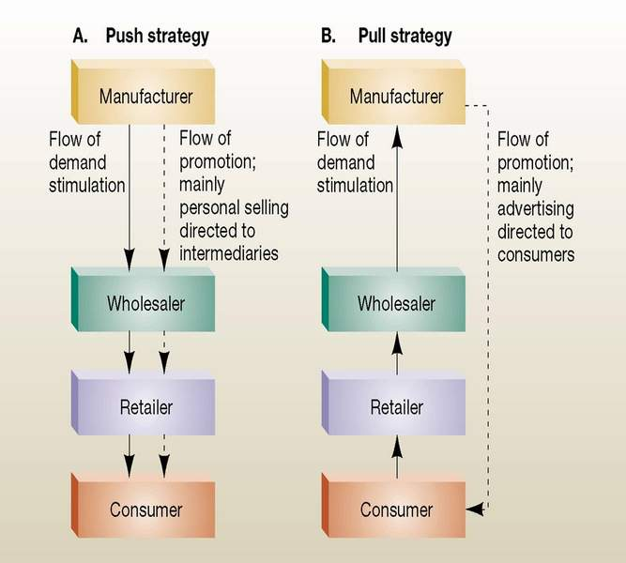

Slide 51
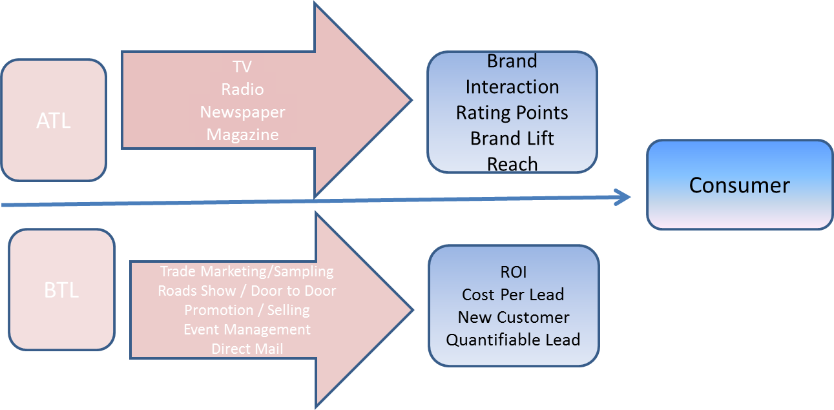
Promotional Activities
ATL – Above the line activities: media - broadcast and published to mass audiences, Print Ads.
BTL – use media that are more niche focused
  Personal Selling, CMEs, Seminars, Symposiums, Clinic Activities, Brand Activities, Sales Promo Activities

Slide 52
ၾကည့္ရွဳစရာခ်န္နယ္ေပါင္း (၅၀၀) ရွိျခင္းရဲ႕ ရလဒ္အျဖစ္ ရုပ္ျမင္သံၾကားက ထုတ္လႊင့္တဲ့ ေၾကာ္ျငာပမာဏဟာလည္း အၾကီးအက်ယ ္ေလ်ာ့ပါးသြားခဲ့တယ္။
ပံုမွန္မီဒီယာေတြျဖစ္တဲ့ သတင္းစာနဲ႔ မဂၢဇင္းေစာင္ေရဟာလည္း ထူးထူးျခားျခားေလ်ာ့က်သြားခဲ့ပါတယ္။
တစ္ဖက္မွာေတာ့ ေစ်းကြက္ေဖာ္ေဆာင္သူမ်ားဟာ အြန္လိုင္းကေနတစ္ဆင့္ အထူးျပဳထုတ္ေဝတဲ့ မဂၢဇင္းေတြနဲ႔ သတင္းအုပ္စုေတြကတစ္ဆင့္ ေၾကာ္ျငာျခင္းအားျဖင့္ ယခုအခါမွာ သူတို႔ရည္ရြယ္ပစ္မွတ္ထားတဲ့ ေစ်းကြက္မ်ားဆီကို ထိထိမိမိ အေရာက္လွမ္းႏိုင္ၾကပါျပီ။
ကုမၸဏီတစ္ခု၏ရည္မွန္းခ်က္ဟာ အက်ိဳးအျမတ္ရွိရွိ တိုးတတ္ဖြံ႕ျဖိဳးျခင္း (Profitable Growth) သာျဖစ္ရပါမယ္။

Slide 53
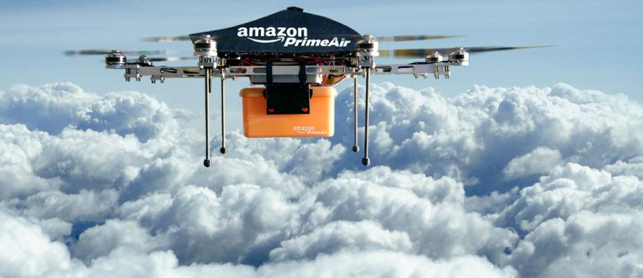
“Amazon”
CEO Bezos - authentic, customer-centric company.
1. Don’t Just Listen to Your Customers, Understand Them
Philosophy = Listening, understanding the customer.
2. Serve the Needs of the Customer
Not competitor obsessed, we’re customer obsessed.
3. The Empty Chair: Most Important Person in the Room
4. Never Settle for 99%
Customers are talking to one another and are referring

Slide 54
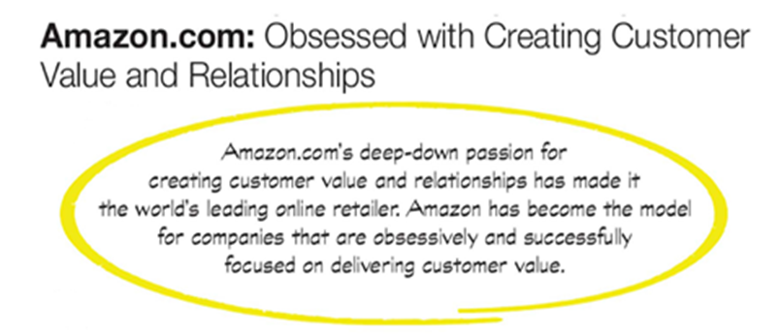
5. Respect Today’s Customer
customers unhappy, each tell six friends. Unhappy on the Internet, tell 6,000.”
6. Strive to Create a Customer-Centric Company
“We don’t focus on the optics of the next quarter; we focus on what is going to be good for customers.”
7. Don’t Be Afraid to Apologize
Apologizing – it’s an open surrender
A solid, heartfelt apology = true representation that cares the needs of the customer, speaks louder than multi-million dollar advertising message

Slide 55
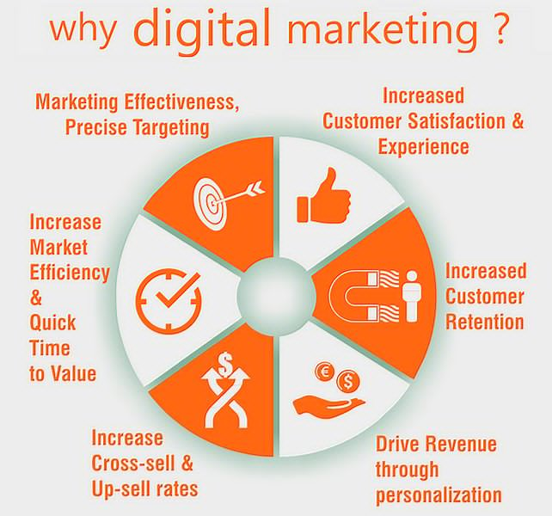
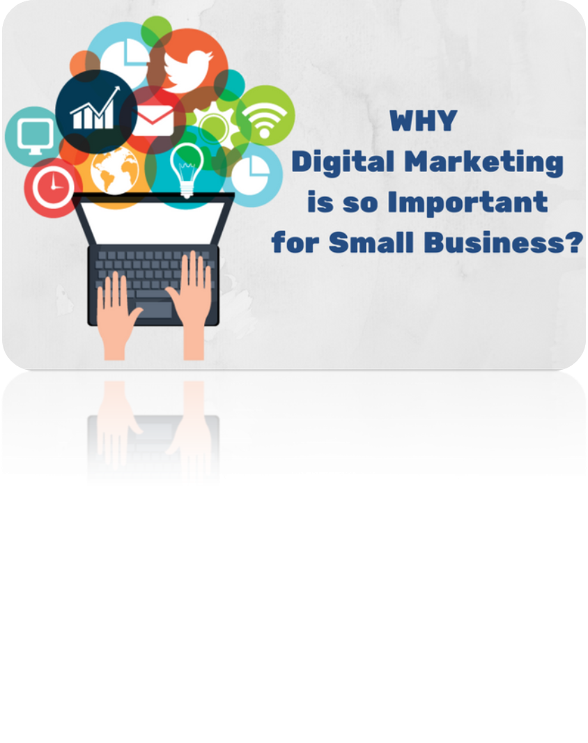
Power Shifts to the Connected Customers
Away from high-volume mainstream brands into low-volume niche ones.
Most customers believe more in the f- factor (friends, families, Facebook fans, Twitter followers) than in marketing communication.
The growth of communal rating systems such as TripAdvisor and Yelp.

Slide 56
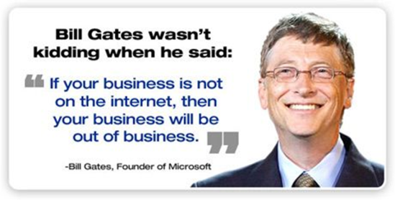

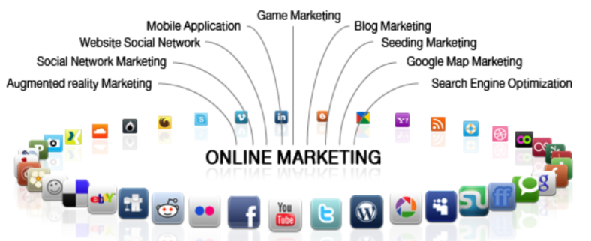

Slide 57
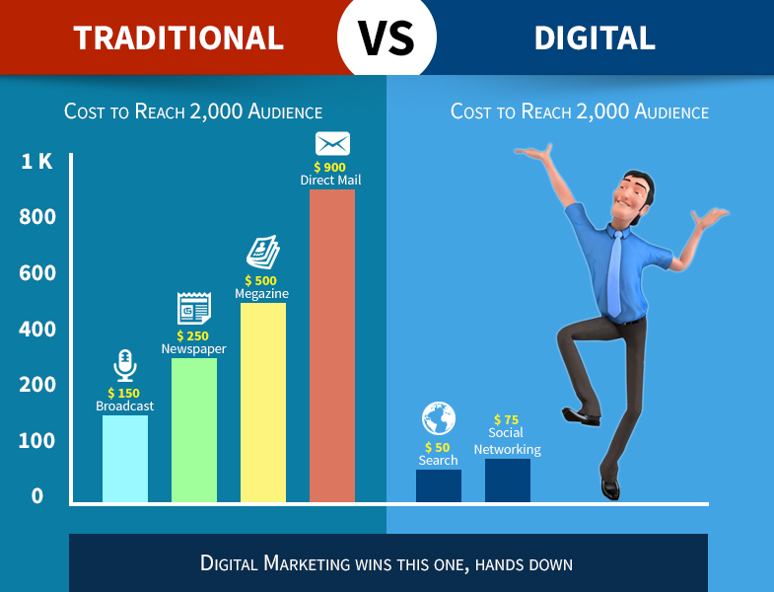

Slide 58
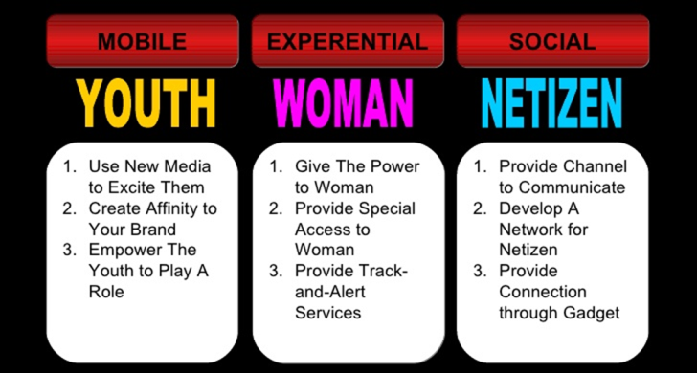

Slide 59
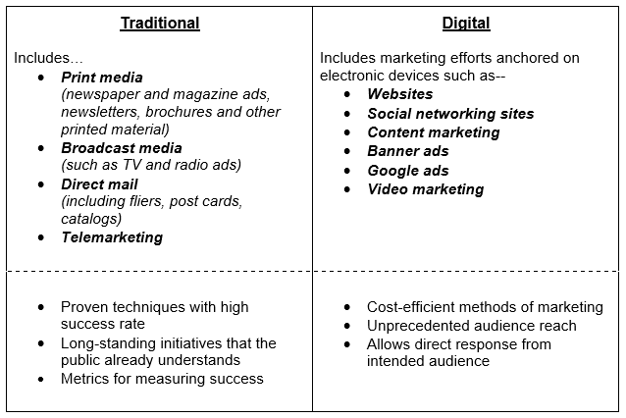

Slide 60
Philip Kotler: The Ten Commandments of Marketing
Chooses the best segments, strong position
Maps needs, perceptions, preferences, and behavior satisfies the customers.
Knows major competitors; strengths and weaknesses.
Builds partners and generously rewards them.
Identify opportunities, choosing the best ones.
Marketing planning : long-term and short-term
Strong control product and service mix.
Strong brands by most cost-effective communication tools.
Marketing leadership and a team spirit among departments.
Constantly adds technology that gives it a competitive advantage

Slide 61
The heart of business success lies in its marketing.
Most aspects of business depend on successful marketing.
The overall marketing umbrella covers advertising, public relations, promotions and sales.
Without marketing, none of your potential customers would know about it.
Without marketing, sales may crash and companies may have to close.

Slide 62
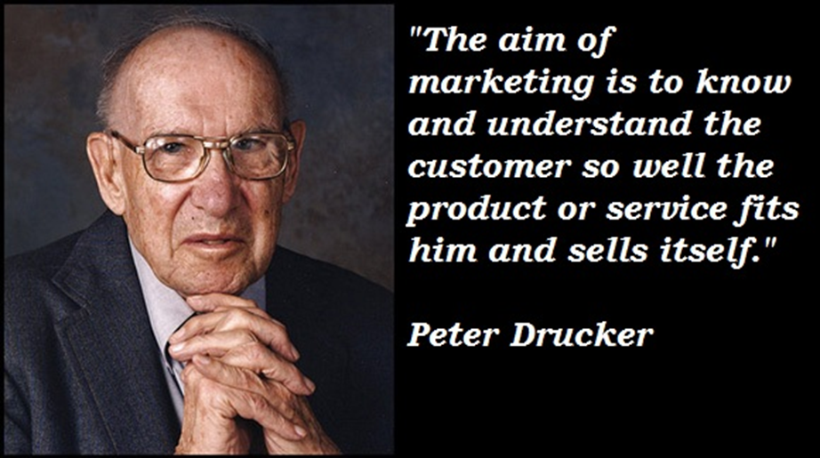
So, What Is Marketing?
Pulling It All Together
Notes:
UNIQUE SELLING PROPOSITION (USP)

Slide 63
M- Mission, Vision
A- Analysis, the Activities
R- Revenue, Reputation
K- Customer is King
E- Evaluation of Marketing Strategies
T- Strategic Thrust
Strategic direction
must come first, sets the direction, like a compass
Strategic thrust
after strategic direction, competitive advantage
bold initiatives

Slide 64
Thank You So Much par khin byar
Happy New Year!
Wishing all the best and success in 2018

